Slide 1
WebCars
Thiago Goncalves
Cody Mulkern

Slide 2
Original Goals
Clean and straight-forward website
Ability to view and post car ads
Leave feedback for sellers to help future buyers

Slide 3
Web-Site Structure:
Front-end API’s and Libraries:
AngularJS – MVC Framework
UI-Router – AngularJS 3rd party library.
Bootstrap – Is a front-end CSS Framework, our design goal was to totally write minimum amount of CSS rules in WebCars.
jQuery – Used mainly for forms validation.
Font Awesome – The iconic font and CSS framework, all of the icon in our website uses the CSS framework.
HTML5 Geolocation – To get the user's longitude and latitude.
Google Geocoder – Send the coordinates and receives a JSON address location.

Slide 4
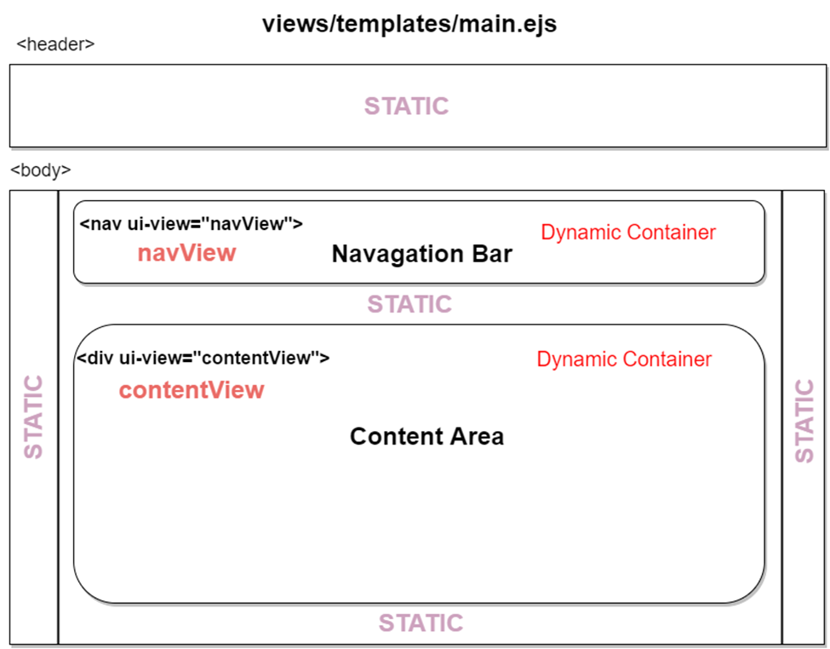
WebCars Layout

Slide 5
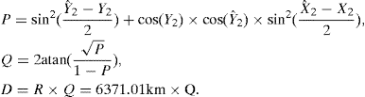
HTML-5 Geolocation
To accomplish the near-by search we used the Haver-sine Algorithm
Haver-sine Algorithm is used to calculate distance between two coordinates, the reason we ask the user to provide the location, was so the algorithm can implemented.

Slide 6
WebCars Version
Version Alpha: Built using HTML and JavaScipt with a MongoDB.
Version Beta: Built using Angular MVC, Node.js, MongoDB.

Slide 7
Achievement
Our goal was to have a fully functioning front-end and back-end website.
We currently only support a local user login strategy. We did not implement a Facebook login strategy because it requires a API key.
We did use Google API to some extent.
Time did not allow to implement a CSS file for Mobile version. But, the website layout is mainly designed to be a mobile friendly application. So it wouldn’t be too much of problem to implement the mobile version.

Slide 8
Demo
https://webcars.herokuapp.com/
OR
http:// 73.38.197.234

Slide 9
Problems
Using github with different IDEs commonly caused conflicts with files that were auto generated by the different IDEs
Encoding images to base 64 creates a long text string. Passing a string of 2mb to the API was a problem because the settings of the Body-Parser Node module had to be changed to support strings that exceeded 1mb.
Heroku has a ephemeral filesystem (Meaning at least every24 hrs Dynos gets cycled, Heroku disk gets deleted and reloads to the original repo).

